Slide 1


Stock Price Forecasting
By Choy Jee Hung Caleb p2341475

Slide 2

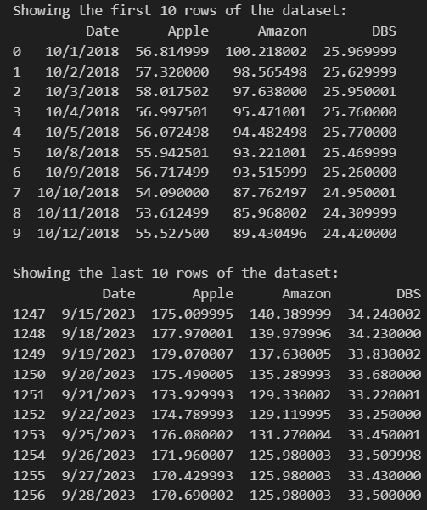
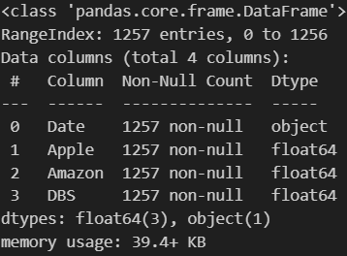
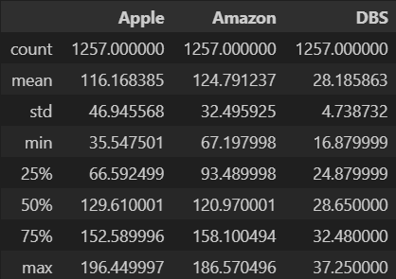
Data Exploration- Dataset
Viewing the first/last 10 rows:
Viewing the info:
Describe:

Slide 3
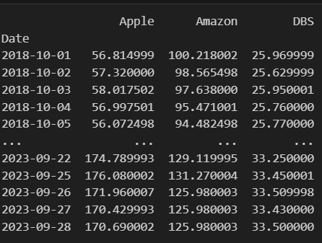
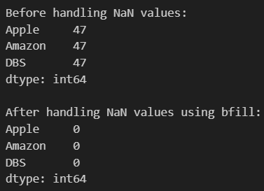
Data Preprocessing
Resolving NaN values that came from setting frequency to B:
Converted date to datetime and freq to B:

Slide 4
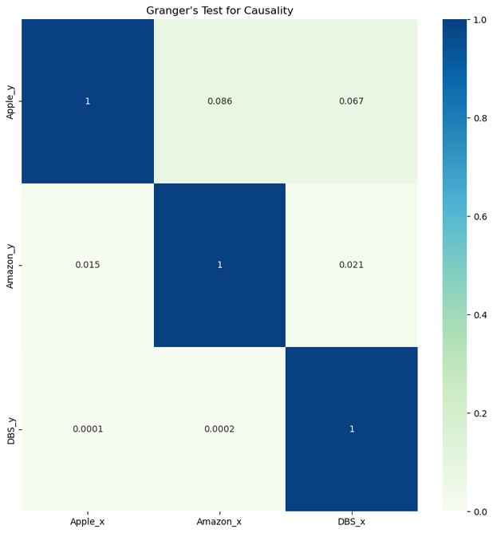
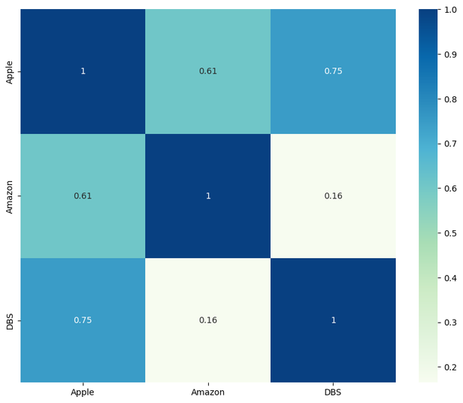
Data Exploration- Correlation
Correlations:
Granger's Test for Causality:
:
The granger test score for Apple against Amazon and DBS is more than that the significant value of 0.05.
This shows that there is no granger casual relationship between Amazon and Apple, and DBS and Apple.
However, the granger test score for Amazon against Apple and DBS, and DBS against Apple and Amazon is less than the significant value of 0.05.
This shows that there is a granger casual relationship between Apple and Amazon, DBS and Amazon, Apple and DBS, Amazon and DBS.
1 indicates a perfect positive correlation
-1 indicates a perfect negative correlation
0 indicates no correlation
Apple and Amazon, Apple and DBS have a strong positive correlation with each other.
Amazon and DBS have a weak positive correlation with each other.

Slide 5
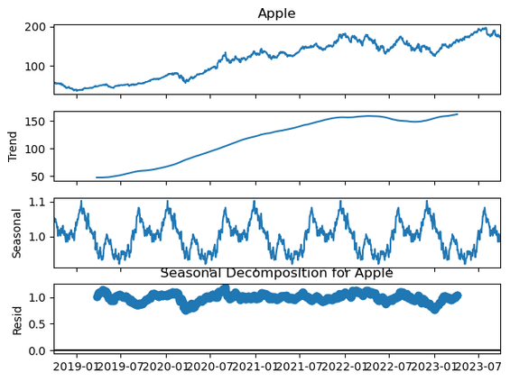
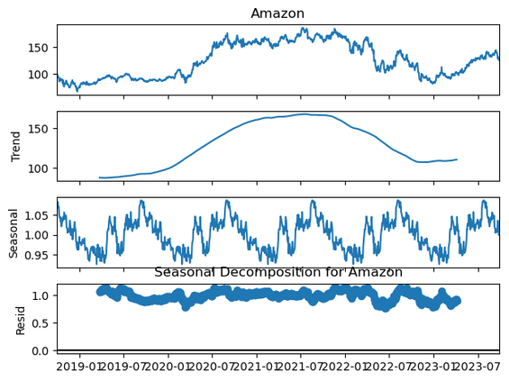
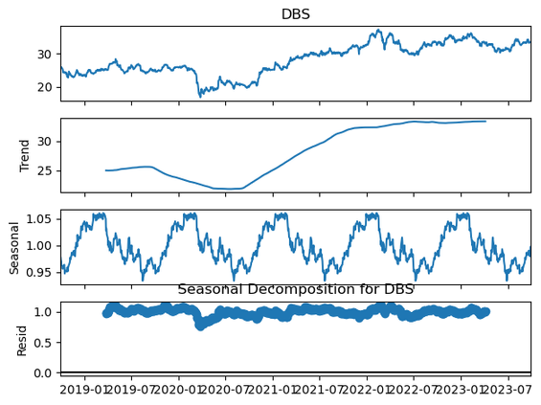
Data Exploration- Seasonal
Original Time Series:
This is the raw data, often plotted as a line graph, showing the observed values over time. It may exhibit trends, seasonal patterns, and irregular fluctuations.
Trend Component:
The trend component represents the long-term movement or direction of the data. It smooths out short-term fluctuations and highlights the underlying pattern.
Seasonal Component:
The seasonal component captures the periodic patterns or fluctuations that occur within a specific period, such as daily, monthly, or yearly cycles. This component reveals regular patterns that repeat over a fixed interval of time.
Residual Component (Irregular or Noise):
The residual component, also known as the irregular or noise component, represents the remaining variability in the data that cannot be explained by the trend or seasonal components. It consists of random fluctuations, outliers, and other unpredictable variations.

Slide 6
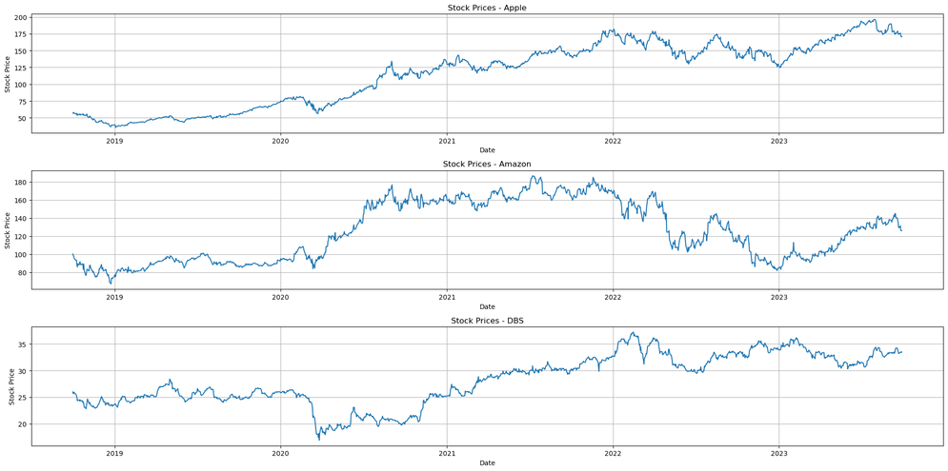
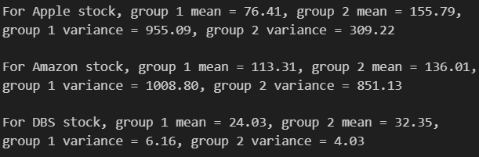
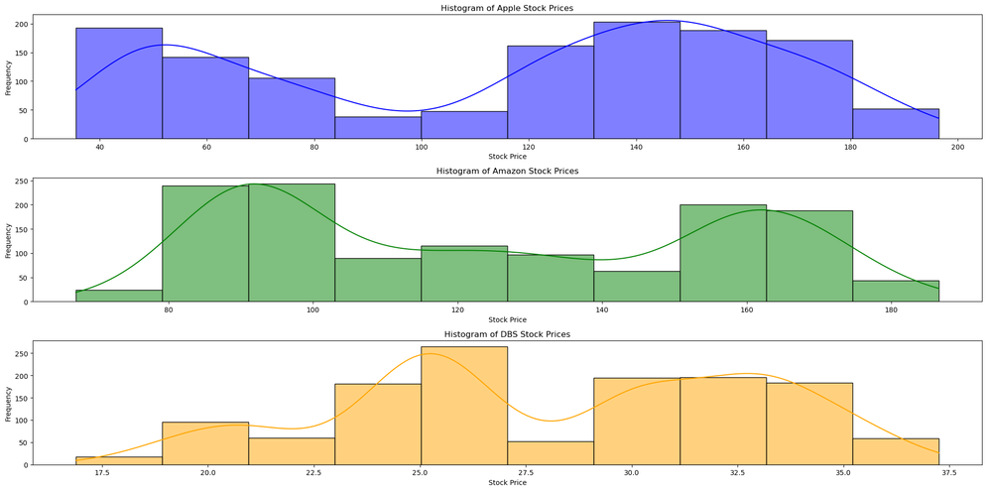
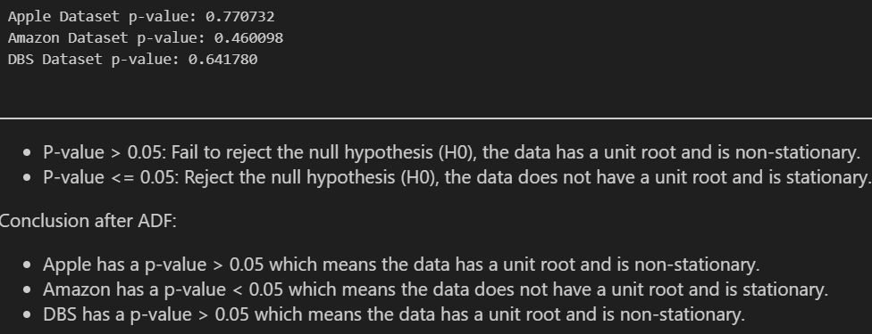
Data Exploration- Checking Stationarity
Visual check:
For a stationary time series, they should always have the same mean and variance values. Since there is a large difference between the mean and variance values of group 1 and group 2 of all stocks, none of the time series are stationary.
Summary statistics:
ADF (Augmented Dickey Fuller) Test:
There is not really a normal distribution observed in any of the prices for the 3 companies. If the time series is stationary, the data should conform to Gaussian distribution (bell curve). Since none of the data conform to that curve, none of the data are stationary.

Slide 7
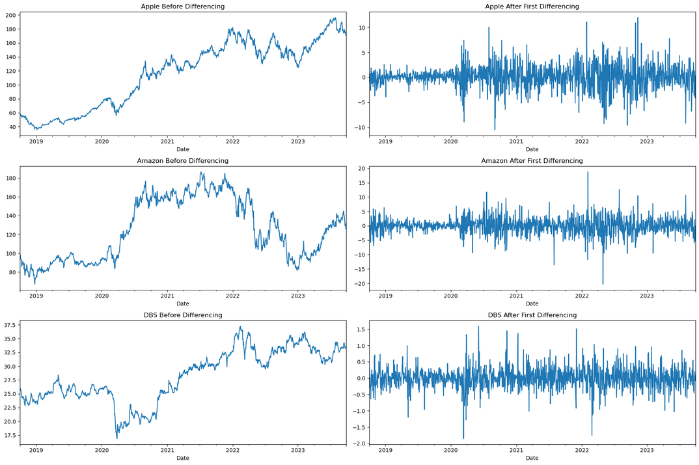
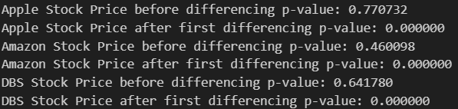
Data Preprocessing - Differencing
Visual check:
We have successfully make the timeseries stationary for use. We have used only first differencing as after first differencing, P-value <= 0.05. We will then reject the null hypothesis (H0) showing that the data does not have a unit root and is now stationary.
ADF (Augmented Dickey Fuller) Test:

Slide 8
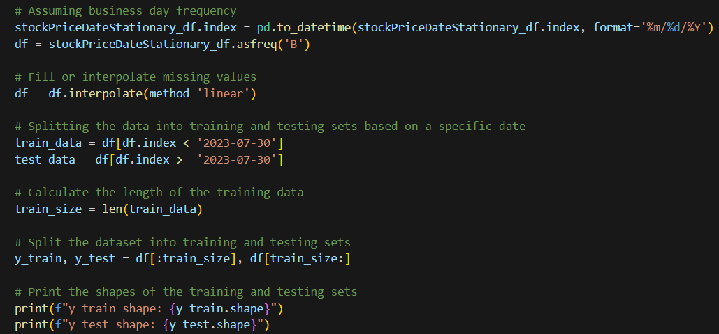
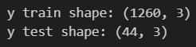
Data Preprocessing - Train Test Split
Visual check:
I will be splitting my data into till 60 days before the end of the dataset which is 2023-07-30 for training, and after 2023-07-30 which is 60 days for testing and forecasting. Splitting data into training and testing is important to allow models to test on unseen data to see how it fares.

Slide 9
Models used:
01
02
03
04
Simple Moving Average
Holt-Winters Seasonal Method
Arima
Sarima

Slide 10
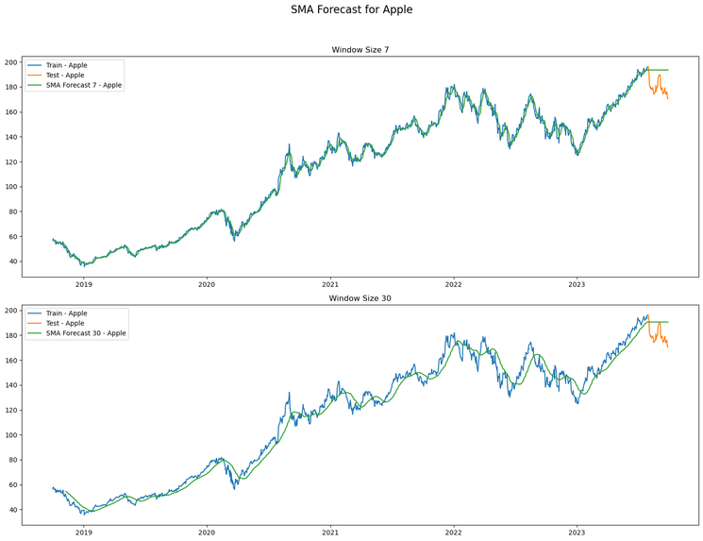
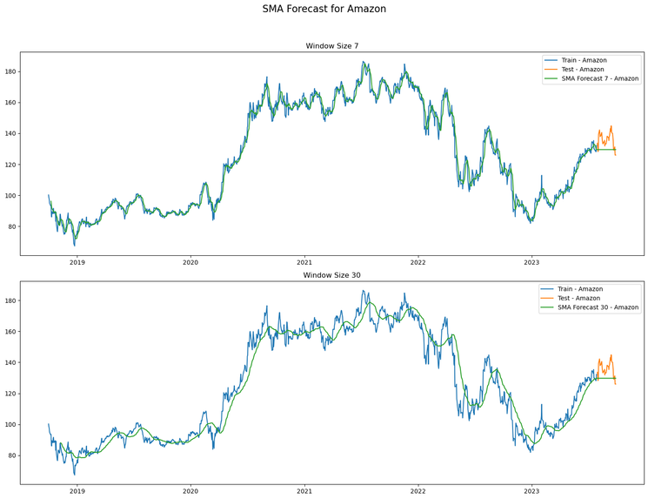
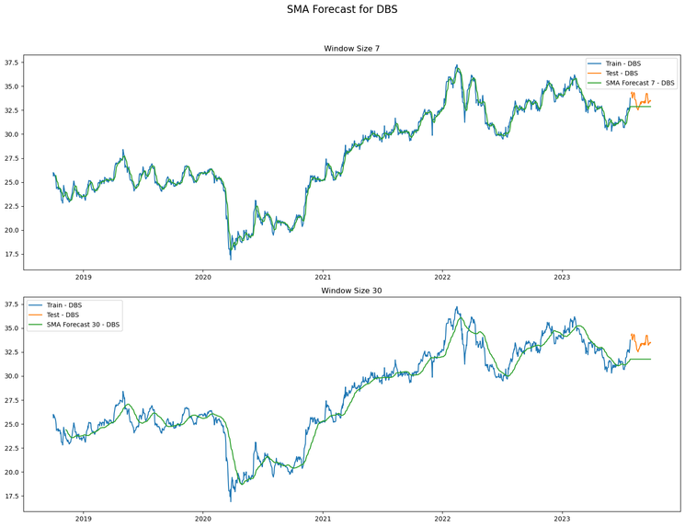
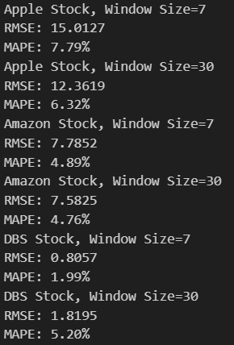
Simple Moving Average:
For Apple stock, increasing the window size leads to a slight improvement in RMSE with a negligible change in MAPE.
For Amazon stock, increasing the window size slightly improves the RMSE and MAPE.
For DBS stock, increasing the window size slightly deproves the RMSE and MAPE.
However, the SMA method is a simple and intuitive approach, but it has limitations. It may not capture complex patterns or changes in the underlying data. It also gives equal weight to all data points within the window, which may not be suitable for all time series. Therefore, we would need to use other advanced methods like exponential smoothing, ARIMA or SARIMA to overcome these limitations and provide more accurate forecasts.

Slide 11
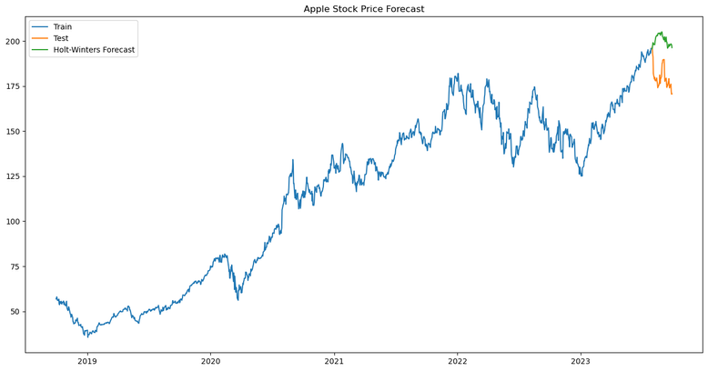
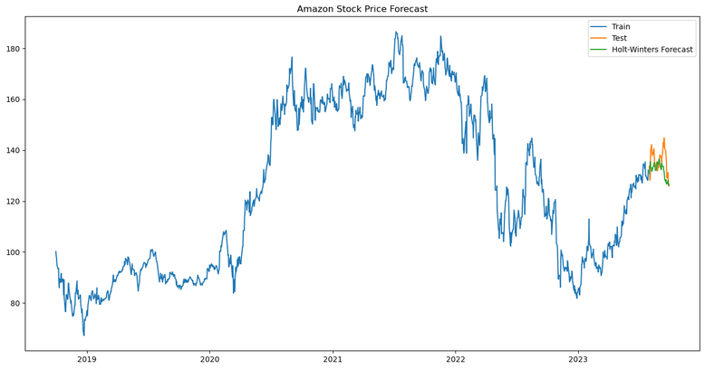
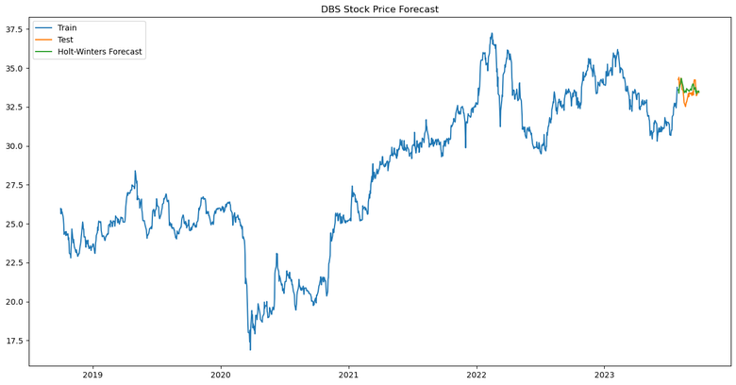
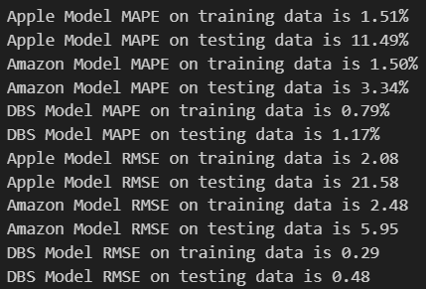
Holt-Winters Seasonal Method
A lower MAPE and RMSE indicate better performance.
In this case, the DBS model seems to perform the best across both training and testing datasets, as it has the lowest MAPE and RMSE values on both. The Apple model performs well on the training data but shows significant performance degradation on the testing data, indicating potential overfitting.
The Amazon model also performs well but not as well as the DBS model on the testing data.

Slide 12
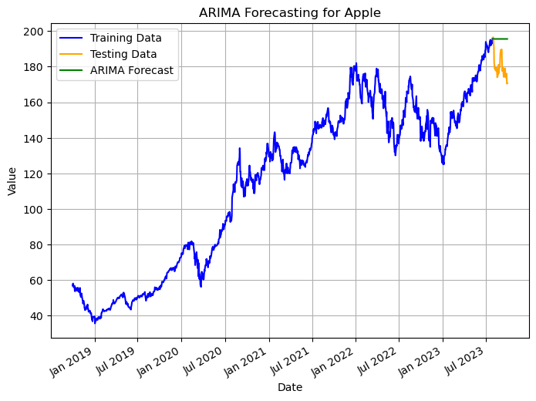
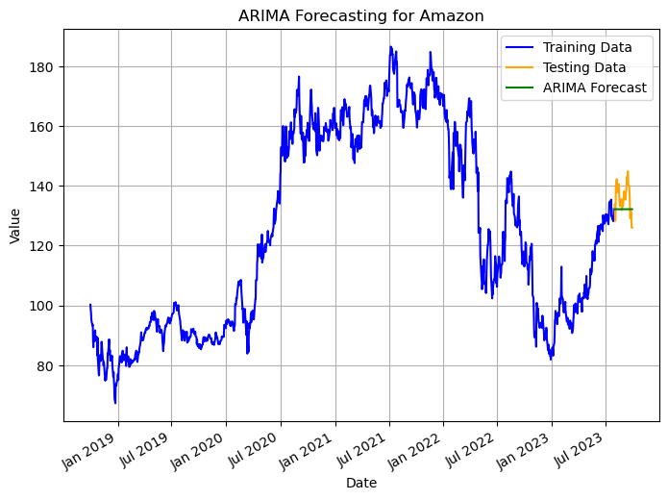
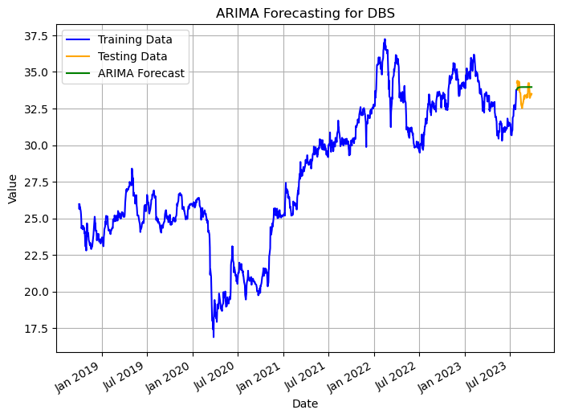
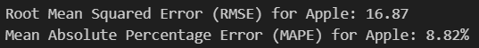
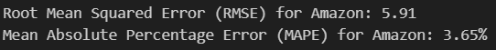
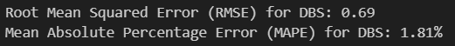
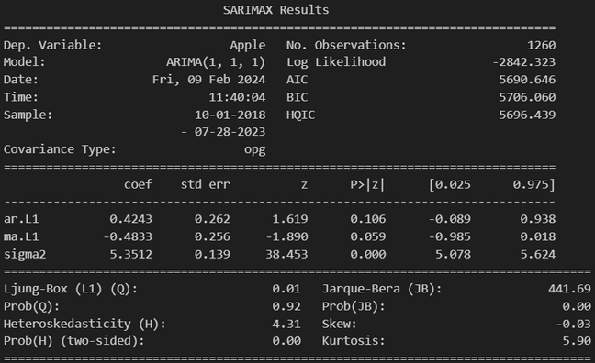
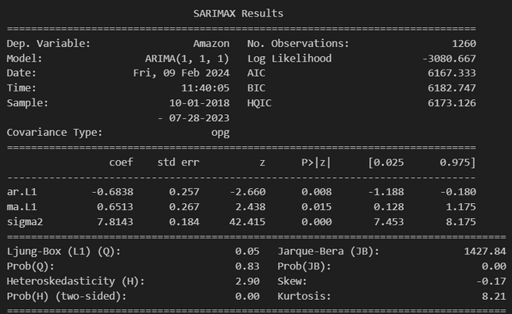
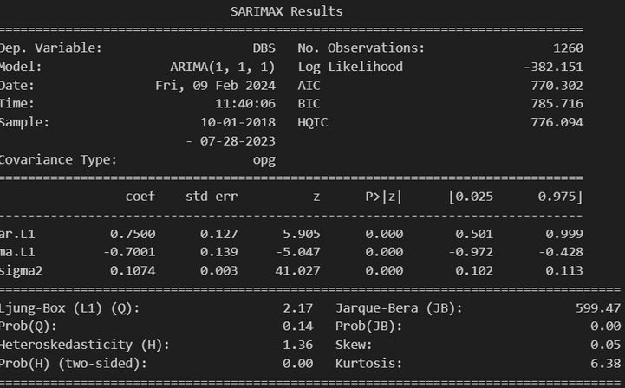
Arima - Without Tuning

Slide 13
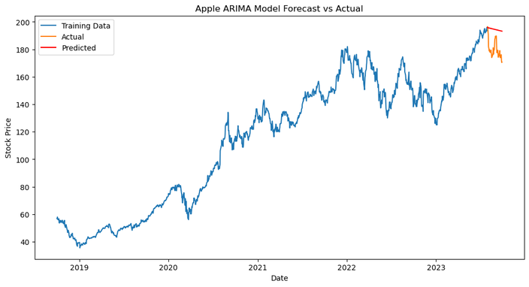
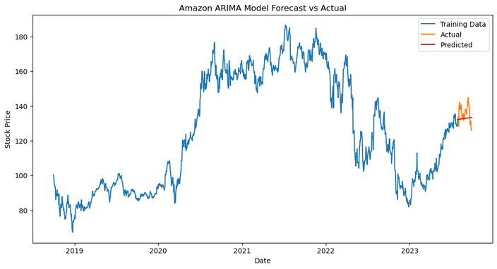
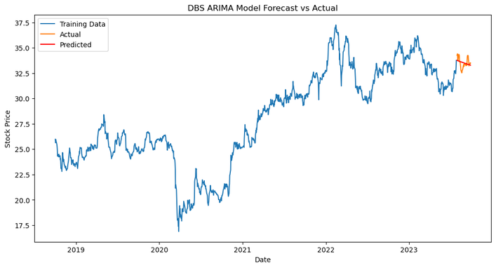
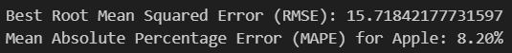
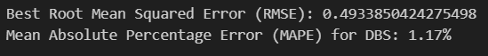
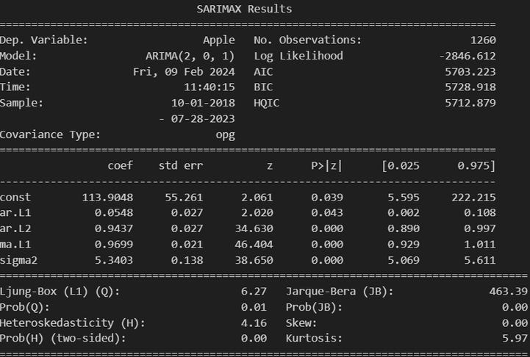
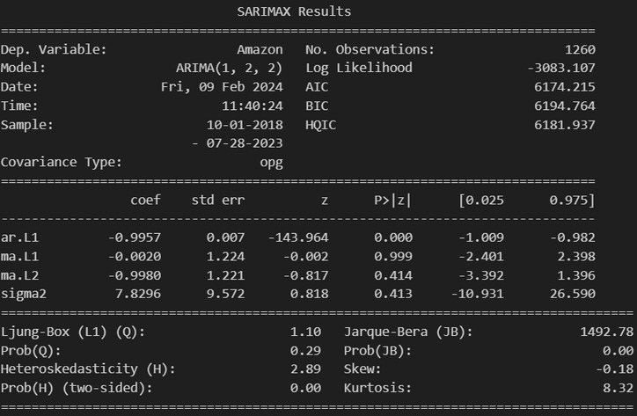
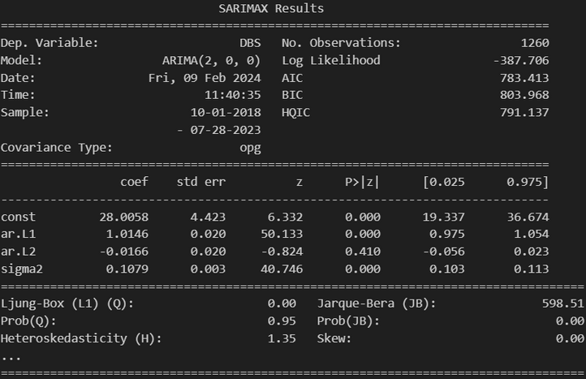
Arima - With Tuning

Slide 14
Arima - With Tuning Evaluation
We have successfully tuned the Arima model to different parameters among a range to find out the best parameters to use with the model. Usually we would use auto ARIMA in order to determine the parameters, however we cannot use it for CA2 and hence usage of inter.
Apple:
Model ARIMA(2, 0, 1) is the order of the ARIMA model.
AIC is 5703.223, which increased from 5690.646.
BIC is 5728.918, which increased from 5706.060.
The RMSE deceased from 16.87 to 15.71 showing the model improved after tuning.
The MAPE decreased from 8.82% to 8.20% showing the model improved after tuning.
Amazon:
Model ARIMA(1, 2, 2) is the order of the ARIMA model.
AIC is 6174.215, which increased from 6167.333.
BIC is 6194.764, which increased from 6182.747.
The RMSE decreased from 5.91 to 5.59 showing the model improved after tuning.
The MAPE decreased from 3.65% to 3.45% showing the model improved after tuning.
DBS:
Model ARIMA(2, 0, 0) is the order of the ARIMA model.
AIC is 783.413, which decreased from 5690.646.
BIC is 803.968, which decreased from 5706.060.
The RMSE decreased from 0.69 to 0.49 showing the model improved after tuning.
The MAPE decreased from 1.81% to 1.17% showing the model improved after tuning.

Slide 15
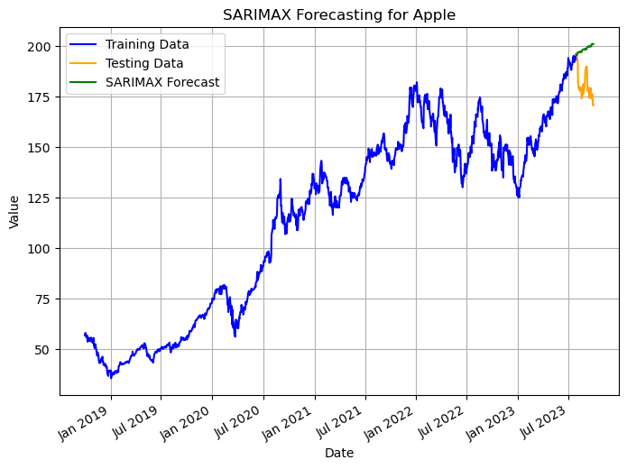
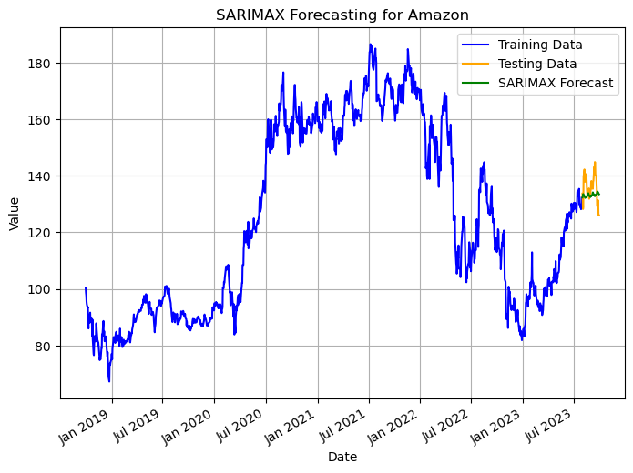
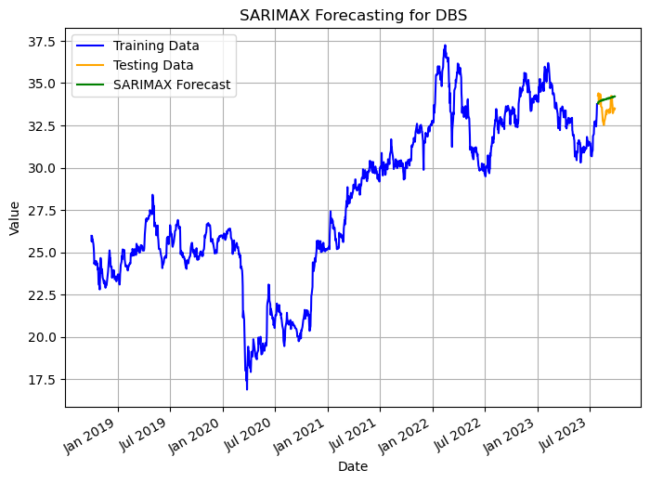
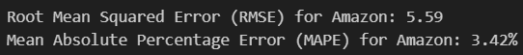
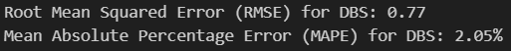
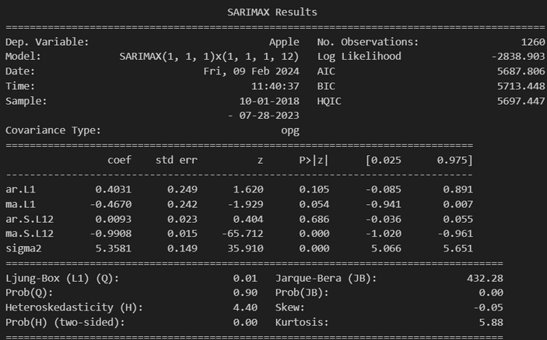
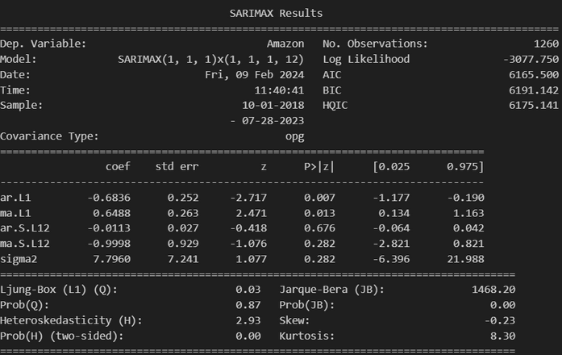

Sarima - Without Tuning

Slide 16







Sarima - With Tuning

Slide 17
Sarima - With Tuning Evaluation
We have successfully tuned the Arima model to different parameters among a range to find out the best parameters to use with the model. Usually we would use auto ARIMA in order to determine the parameters, however we cannot use it for CA2 and hence usage of inter.
Apple:
Model SARIMAX(0, 0, 2)x(1, 1, [1], 12) is the order of the ARIMA model.
AIC is 7019.543 which increased from 5687.806.
BIC is 7045.189 which increased from 5713.448.
The RMSE is 13.18 which decreased from 19.90 showing the model improved after tuning.
The MAPE is 6.76% which decreased from 10.44% showing the model improved after tuning.
Amazon:
Model SARIMAX(1, 2, 1)x(1, 1, 1, 12) is the order of the ARIMA model.
AIC is 6176.772 which increased from 6165.500.
BIC is 6202.410 which increased from 6191.142.
The RMSE is 5.33 which decreased from 5.59 showing the model improved after tuning.
The MAPE is 3.14% which decreased from 3.42% showing the model improved after tuning.
DBS:
Model SARIMAX(2, 0, 2)x(1, 0, [], 12) is the order of the ARIMA model.
AIC is 782.451 which decreased from 828.418.
BIC is 813.285 which decreased from 854.061.
The RMSE is 0.48 which decreased from 0.77 showing the model improved after tuning.
The MAPE is 1.14% which decreased from 2.05% showing the model improved after tuning.

Slide 18



Model Evaluation
A lower RMSE and MAPE indicate better performance.
The lowest RMSE and MAPE is found in Sarima model with hyperparameter tuning.
It has the lowest RMSE and MAPE among all other models which indicates it is the best fit for this data.

Slide 19
Conclusion
With the lowest RMSE and MAPE for all 3 stocks present in the data, it is clear that Sarima is the best model to use.
Hence, we would be using the SARIMA model with hyper-paremeter tuning in order to forecast the stock market for Apple, Amazon and DBS.

Slide 20
Thank you

